Slide 1
Predicting performance drops without ground truth labels
Results summary (data balancing)
1ST NOVEMBER 2023

Slide 2
Methods

Slide 3
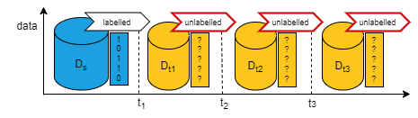
Unlabelled batch learning scenario

Slide 4
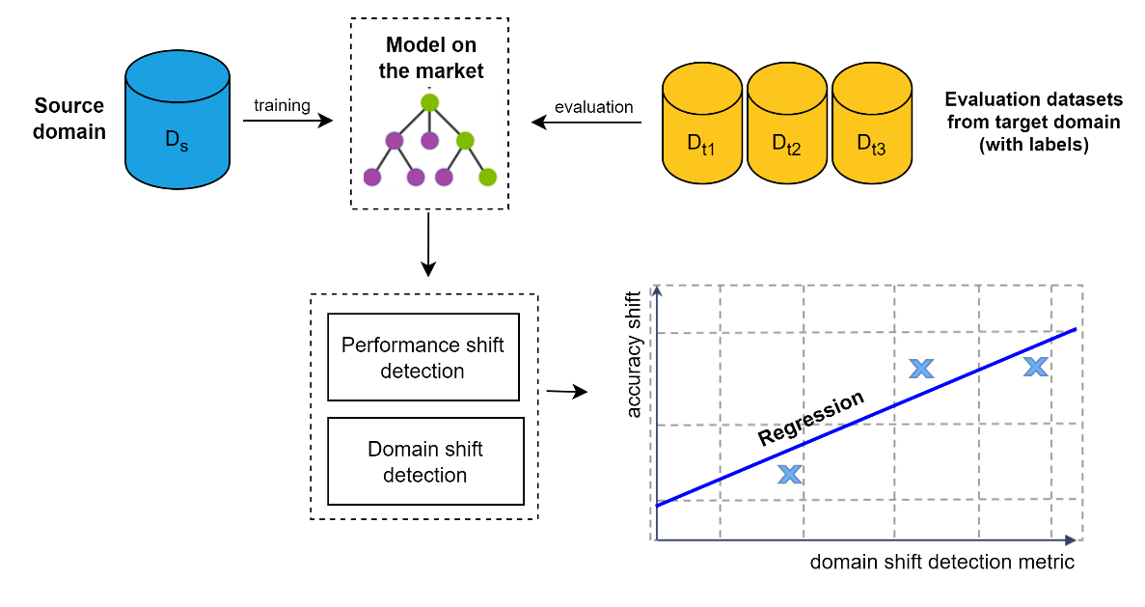
Regression of performance shift (on labelled sets)

Slide 5
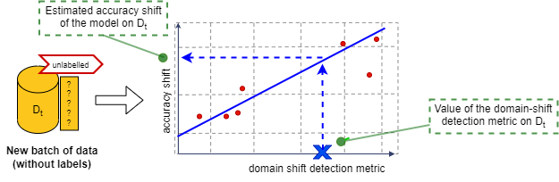
Prediction of performance shift (on new unlabeled set)

Slide 6
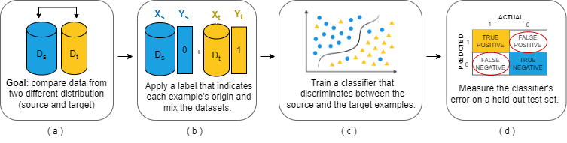
Metrics to predict performance shift
1) Discrimination error

Slide 7
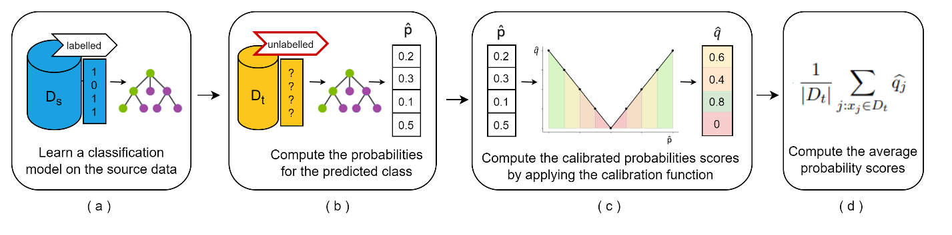
Metrics to predict performance shift
2) Average certainty score (AVRS)

Slide 8
Results Simulated data (AGRAWAL)

Slide 9
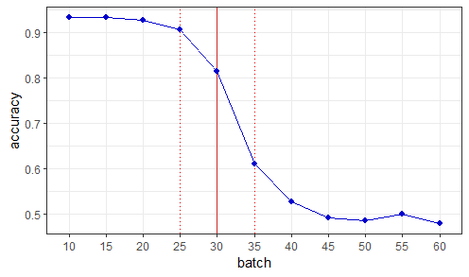
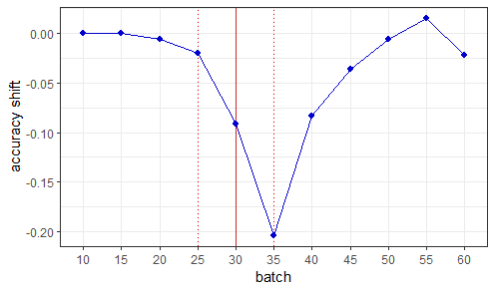
Simulated data (gradual drift at 30th instance)
*The shift is computed between subsequent batches

Slide 10
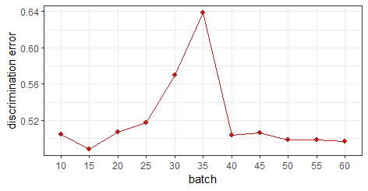
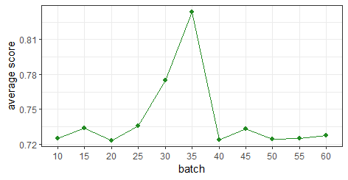
Metrics computation
*Something is actually changing around the instance where the drift is happening (spotted by both metrics)

Slide 11
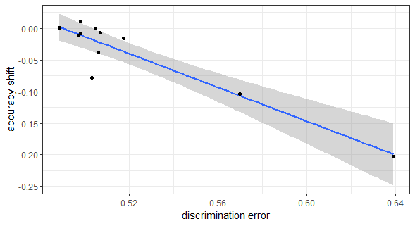
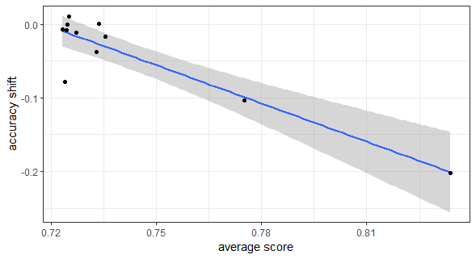
Regression models
*Negative correlation for both metrics.

Slide 12
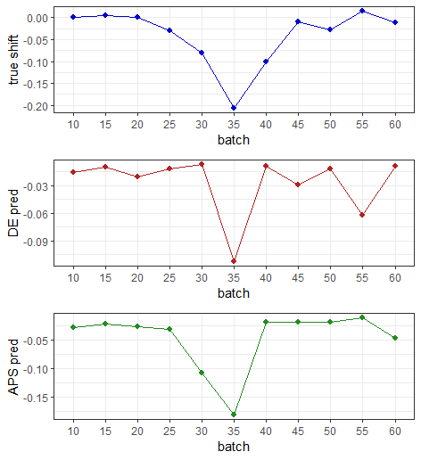
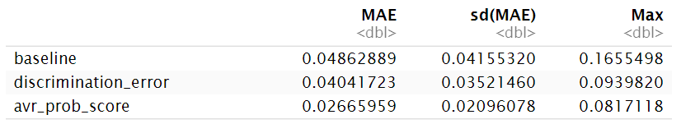
Shift prediction
*AVR score is the metric performing better in predicting the shifts.

Slide 13
Thought #1
When the discrimination error (DE) increases, it means that the models is struggling to separate between the source data (Ds) and the target data (Dt). It should indicate that the domains are similar (NO DRIFT ?).
Similar for the Average certainty score (AVRS). When it increases, it means that the model is more confident about its predictions. (NO DRIFT?)
For this reason, for the SIMULATED DATA, we were expecting the peak in the opposite direction.
Why it isn’t instead? Is it something to do with the generation method?

Slide 14
AGRAWAL generator
This generator consists of six numeric attributes and three categorical attributes to describe the hypothetical loan applications. For the numeric attributes, there is a perturbation factor that makes to shift the true value by adding an offset. It can produce ten different functions to determine whether the loan should be approved or not. The concept drift happens by changing the functions.
Reference: https://moa.cms.waikato.ac.nz/tutorial-5-simulating-concept-drift-in-moa/
Feature | Description | Type
salary | salary | continuous
commission | commission | continuous
age | age | continuous
elevel | education level | categorical
car | car maker | categorical
zipcode | zip code of the town | categorical
hvalue | house value | continuous
hyears | years house owned | continuous
loan | total loan amount | continuous
Dataset | Total instances | No. of classes | No. of drifts | Drift type | Drift width
Agrawal-60K | 60,000 | 2 | 1 | Gradual | 10,000

Slide 15
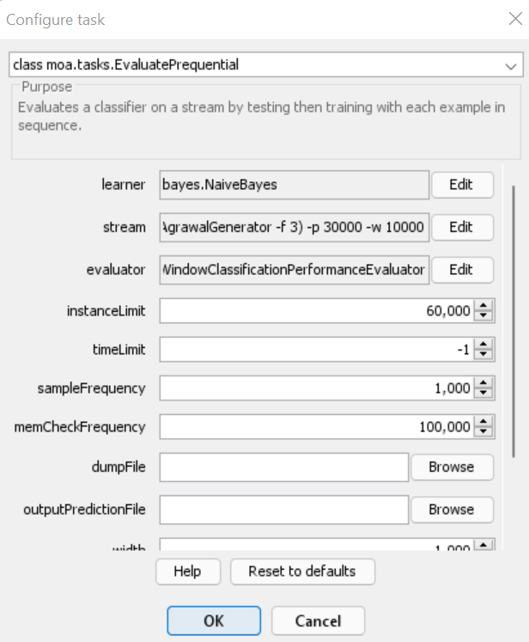
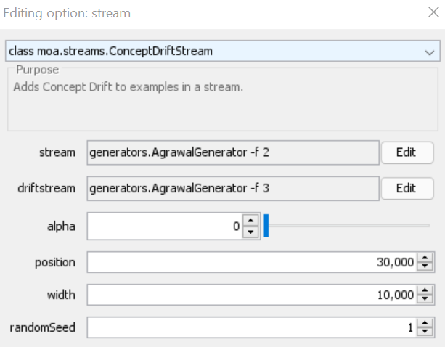
Simulating Concept drift with MOA
To simulate the drift, we use two different perturbation functions (f2, f3) to generate the instances.

Slide 16
Thought #1
However, the prediction of the shift seems to be pretty accurate (better for the AVR score, as the error is lower)

Slide 17
Results Covid-19 data (accuracy, RF model)

Slide 18
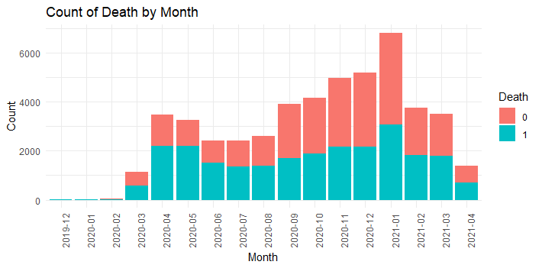
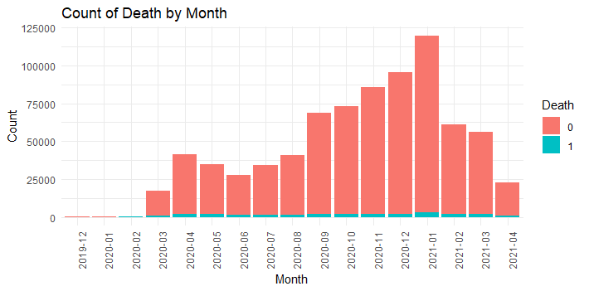
Balancing data
*Thought: we noticed that precision of the model over the batches was extremely low. We then decided to balance the data by under sampling the majority class (Death=0)
Original data
After under sampling majority class (death=0)

Slide 19
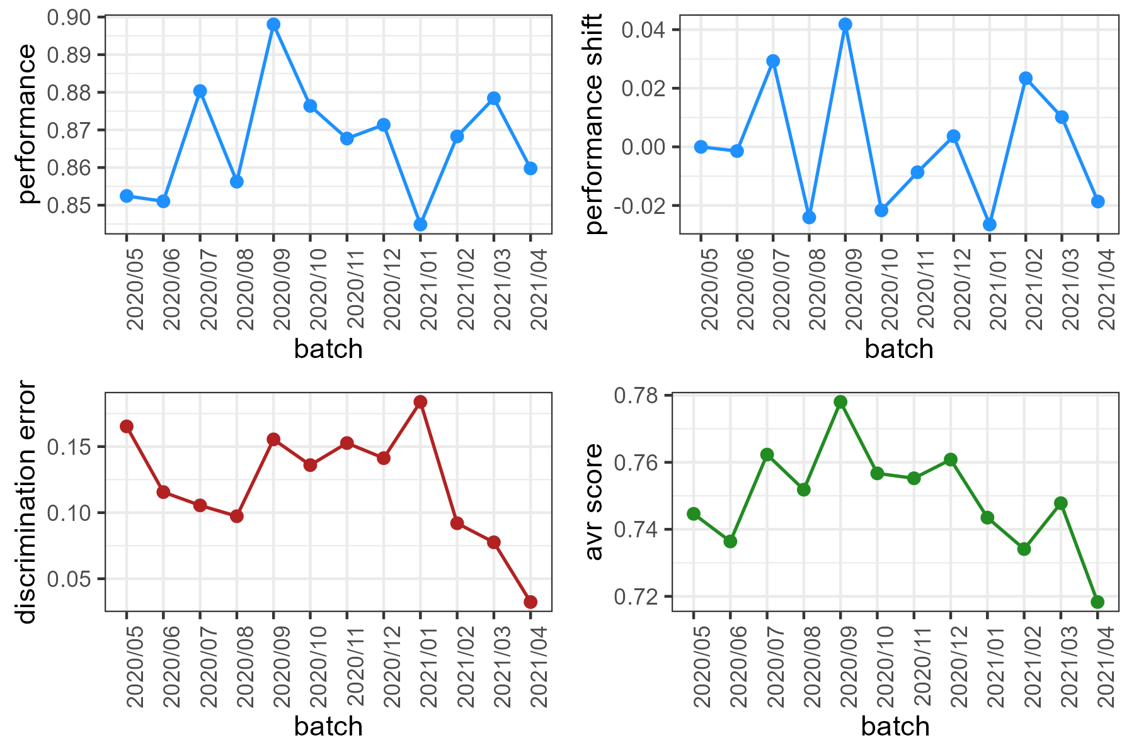
COVID-19 data (accuracy, RF model)

Slide 20
Metrics computation
*When DE decreases, the model easily split source data with target data, that is the domain are very different (indicates shift).
Same for the average certainty score.

Slide 21
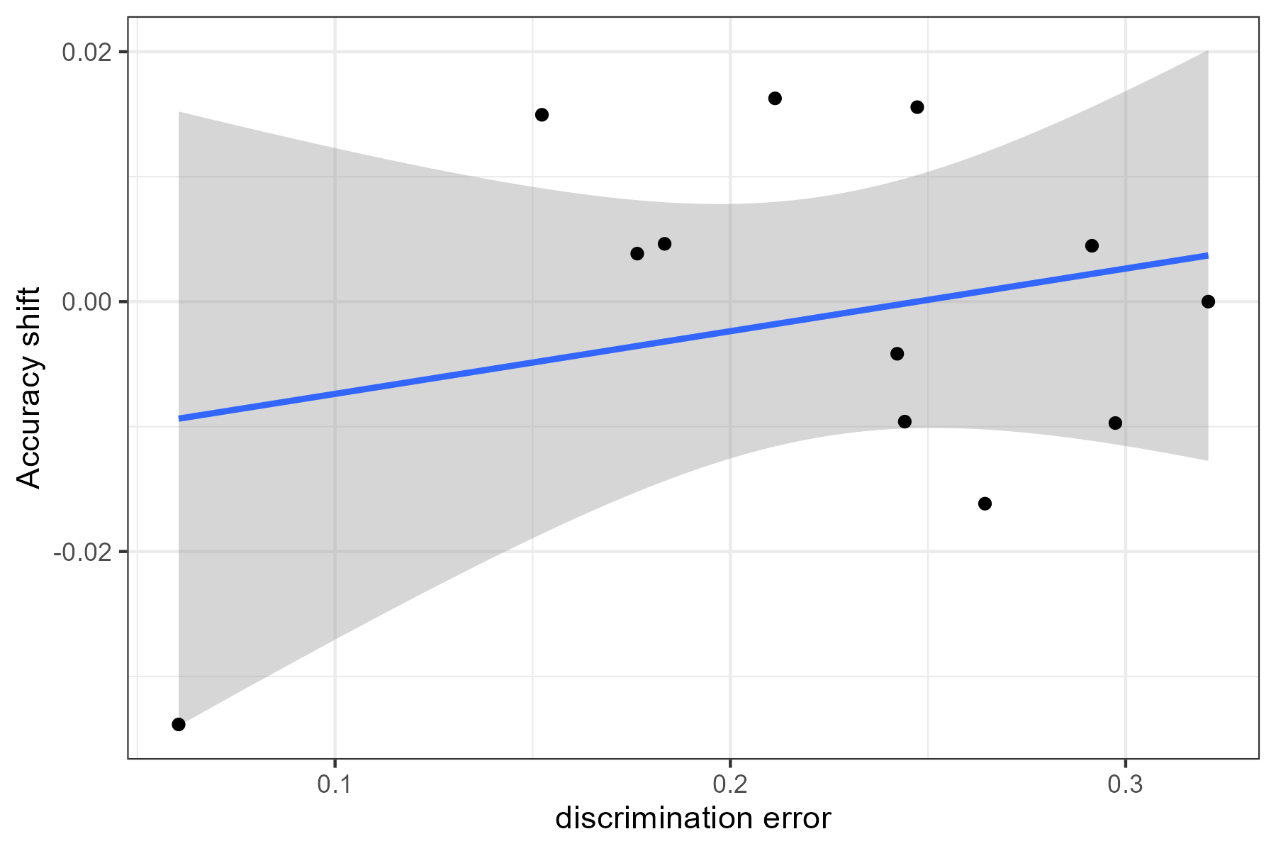
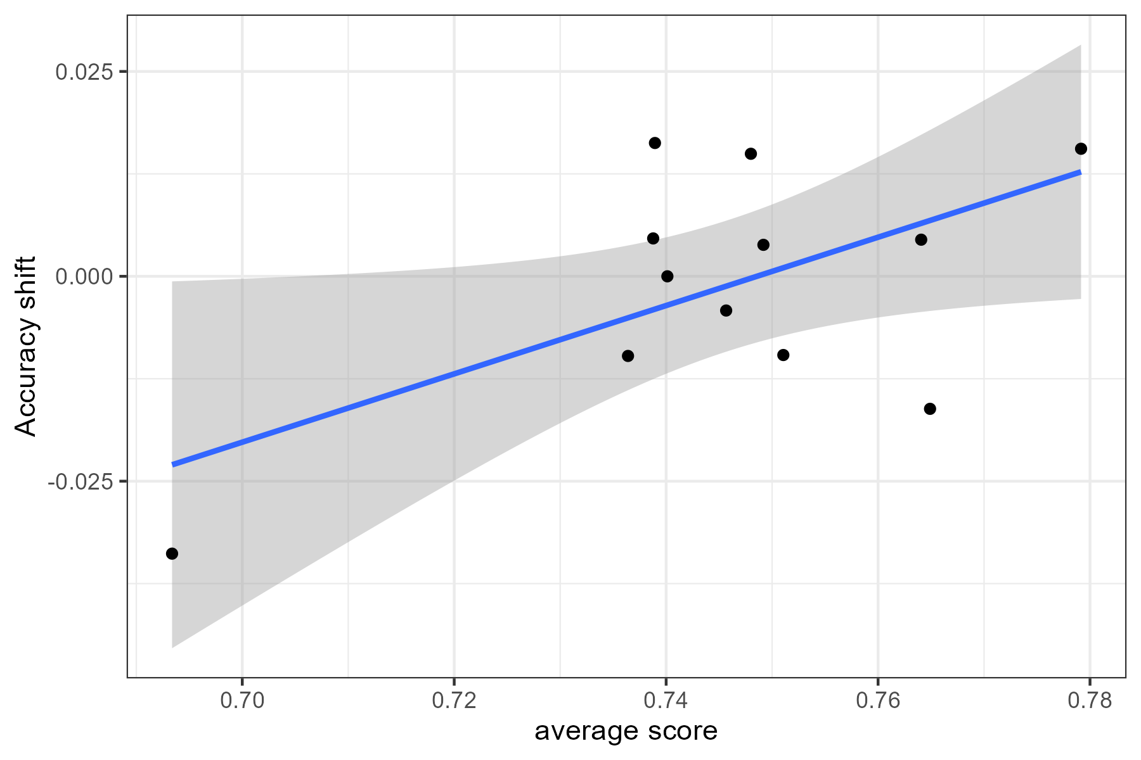
Regression models
*Positive correlation for both metrics.

Slide 22
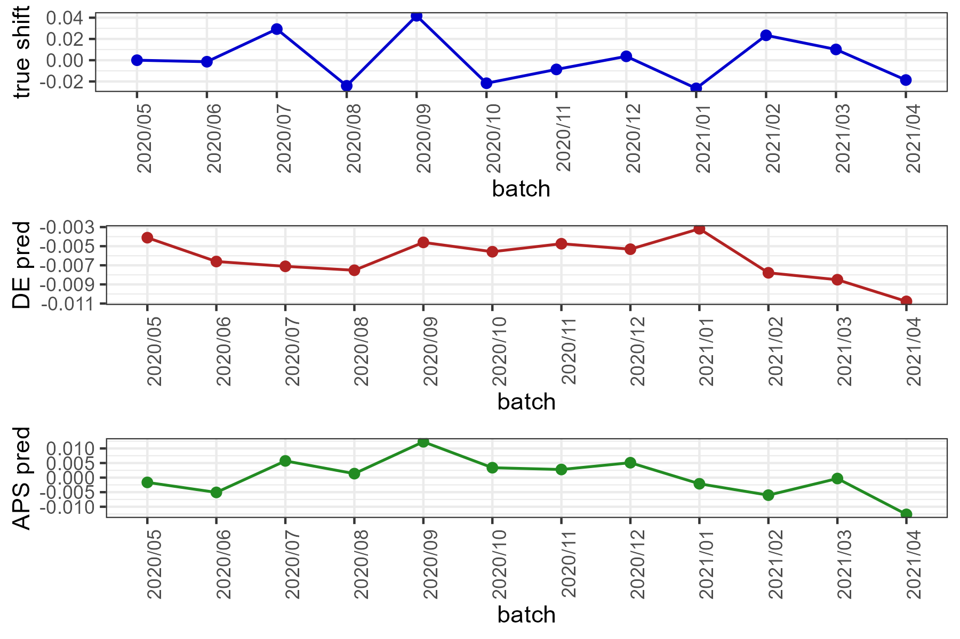

Shift prediction
*AVR score is the metric performing slightly better in predicting the shifts.

Slide 23
Results Covid-19 data (recall, RF model)

Slide 24
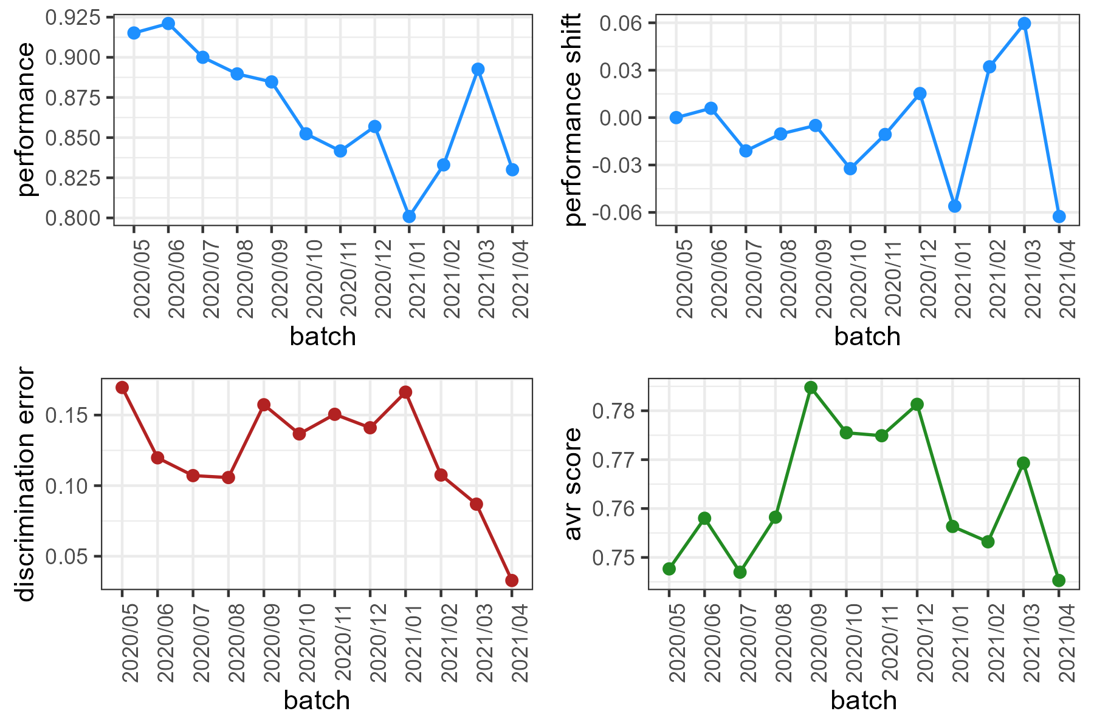
COVID-19 data (recall, RF model)
*recall assumed much higher values now. The trend is decreasing with a spike in the last batches.

Slide 25
Metrics computation
*When DE decreases, the model easily split source data with target data, that is the domain are very different (indicates shift).
Same for the average certainty score.

Slide 26
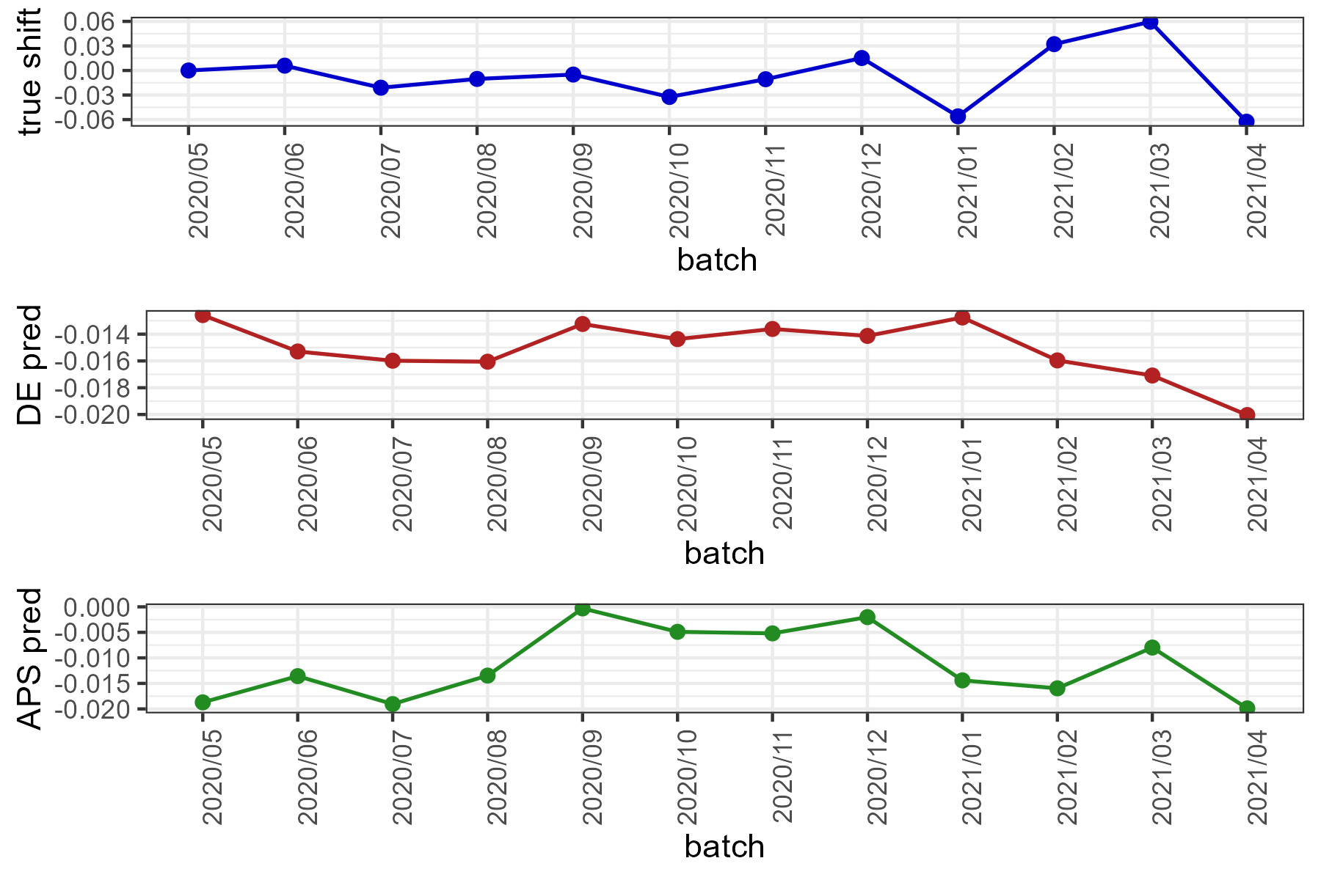

Shift prediction
Slightly better predictions using the AVR metric.

